Slide 1
Study of a Community Evolution Model

Slide 2
Introduction
Community Evolution Theory has wide ranging application in the field of environmental science, biology, social evolution theory, behavioral science etc.
It can be studied through different approaches, such as, game theory, urn theory, graph and network modelling, simulation study etc. For example, in some cases game theoretic approach has been used to study a disease propagation model.

Slide 3

Model Description
Suppose we have finite number of communities (say {$c_{1},c_{2},…,c_{l}$} $l∈N$) and finite number of types (say {$θ_{1},θ_{2},..,θ_{k}\} k∈N$).
At the initial stage in each of these communities we have some positive population.
At each discrete time point $t∈N$, one person based on his type and adoption strategy joins any one of the communities. $θ^{t}∼λ_{t}$ denotes type of the person coming at time $t$.
Initially the total population taking sum over all communities was $m∈N$ which was finite.
Suppose $Y_{t}\left(ω\right)$=$\left(Y_{t}^{1}\left(ω\right),Y_{t}^{2}\left(ω\right),…,Y_{t}^{l}\left(ω\right)\right)$ where $Y_{t}^{j}\left(ω\right)$ denotes the number of person in the $j$th community at time $t$.
Define the fraction of population as $X_{t}\left(ω\right)=\frac{Y_{t}\left(ω\right)}{m+t}$ .

Slide 4

Adaption strategies
There may be various types of adaption strategies. Two of them are discussed below.
In probabilistic adaption strategy if type $θ_{i}$ is selected then community $c_{j}$ will be selected with probability $ρ_{ij}\left(X_{t}\left(ω\right)\right)$.
In adaption strategy using utility after selection of type that particular community is selected for which utility is maximized

Slide 5

Focus of Study
We want to know as $t →∞$, how does this $X_{t}\left(ω\right)$ changes.
Whether it converges or not.
For the limit of $X_{t}\left(ω\right)$ , whether there exist any deterministic limit or it converges to a random variable when we start with some fixed $X_{0}\left(ω\right)$ and adaption rule.

Slide 6

Assumptions
Suppose $l=k$, that is the number of communities is equal to number of types. Now we consider the utility adaption strategy $u_{ij}\left(X_{t}\left(ω\right)\right)$ = $u_{ij}×X_{t}^{j}\left(ω\right)$ with $u_{ii}$ = 1 and 0 otherwise.
Now it is clear that in this case if type $θ_{i}$ is selected the utility is maximized uniquely for the community $c_{i}$.

Slide 7

Community Evolution Theory via Urn Model
We start with the simplest case when $l=k=2$. Here $Y_{t}\left(ω\right)$ has two components that is $\left(Y_{t}^{1}\left(ω\right),Y_{t}^{2}\left(ω\right)\right)$. Let $Y_{t}^{1}\left(ω\right)=a$ and $Y_{t}^{2}\left(ω\right)=b$ here $a,b >0$ and a + b = m. Then, we can express the reinforcement in the communities according to the following structure :
$Y_{t+1}^{1}\left(ω\right)=Y_{t}^{1}\left(ω\right)+I_{\{U_{t+1}≤X_{t}^{1}\left(ω\right)\}}$
$Y_{t+1}^{2}\left(ω\right)=Y_{t}^{2}\left(ω\right)+I_{\{U_{t+1}>X_{t}^{1}\left(ω\right)\}}$
$U_{t+1}$ is a random number from $U(0,1)$ independent of t, using which we decide which community to join.
Theorem : The random variable $X_{t}^{1}\left(ω\right)$ converges almost surely to a random variable (limit) $X^{1}\left(ω\right)$ where $X^{1}\left(ω\right)→$ Beta(a , b) with support in (0, 1). In particular when a = b = 1 then $X^{1}\left(ω\right)$ has U(0, 1) distribution.

Slide 8

Community Evolution Theory via Urn Model
For any $l=k∈N$ then the following theorem holds.
Theorem : Suppose we have $l$ communities and $k$ types where $l=k$. In $X_{0}\left(ω\right)$ we have each and every component strictly positive. We have $P\left[θ^{\left\{t+1\right\}}=θ_{i}\right]=X_{t}^{i}\left(ω\right)$ and $ρ_{ii}=1$ for all i = 1(l)l and 0 otherwise. Under this community evolution scheme the following almost sure convergence holds.
$$X_{t}\left(ω\right)→\left(S_{1},S_{2},⋯,S_{l−1},S_{l}\right)$$
$\left(S_{1},S_{2},….,S_{l}\right)$ is random vector with Dirichlet density
$$Γ\left(\sum_{j=1}^{l}{Y_{0}^{j}\left(ω\right)}\right)\prod_{j=1}^{l}{\frac{s_{j}^{Y_{0}^{j}\left(ω\right)−1}}{Γ\left(Y_{0}^{j}\left(ω\right)\right)}}$$

Slide 9

Fixed Probability Community Evolution
Here we assume that $l=k∈N$ and $ρ_{ij}=\frac{1}{l}$ for all $i,j=1(1)l$. That is after selection of a type all communities are equally likely to be selected.
For this case our main interest is if we start with equal number of person in each community, will $X_{t}\left(ω\right)→\left(\frac{1}{l},\frac{1}{l},..,\frac{1}{l}\right)$.
We perform a basic simulation study for this. We start with $Y_{0}\left(ω\right)=\left(10,10,10,10,10\right)$ with $l=k=5$. We take 1000 iterations that is $t=1(1)1000$. We perform 6 simulations.

Slide 10

Fixed Probability Community Evolution
SL.NO. | C1 | C2 | C3 | C4 | C5
1 | 0.2105 | 0.2095 | 0.2067 | 0.1914 | 0.1819
2 | 0.2029 | 0.1952 | 0.2057 | 0.2076 | 0.1886
3 | 0.1943 | 0.2200 | 0.1924 | 0.1838 | 0.2095
4 | 0.1886 | 0.1733 | 0.2143 | 0.2067 | 0.2172
5 | 0.1952 | 0.2181 | 0.1876 | 0.1895 | 0.2095
6 | 0.1933 | 0.2086 | 0.2029 | 0.1933 | 0.2019

Slide 11

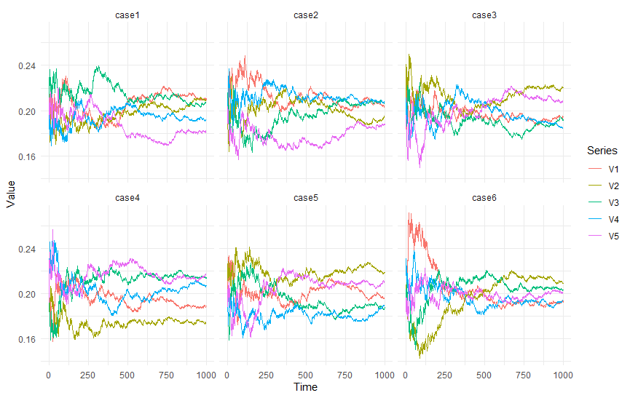
Fixed Probability Community Evolution

Slide 12

Fixed Probability Community Evolution
So even after starting with a symmetric population from the plot and table it is clear that as $t →∞$ the limiting proportion does not converge to a particular value. Rather it is very random in nature. Even from the trajectory given below it is clear that all proportions are very close to 0.2, but they exactly do not converge. Rather they oscillate between a particular band.

Slide 13

Graph Based Community Evolution
Define a graph $G= (V,E)$ where $V=\{1,2,..,k\}.$ This is a finite graph where each and every vertex are connected to each other. $(j`,j) ∈ E$ where $j`,j=1(1)l$. W(e, 0) = 1 for all e $∈$ E, implying initially all communities are equally likely to join. We start the random walk at i , note that at t = 0 no person joins any of the communities. Suppose $L_{t}$ denotes the position of random walk at time t. If at time point t the random walk is on vertex j then we say that at t, one person joins $c_{j}$ . The probability of transition is given by,
$$P\left(L_{t+1}=j | ℱ_{𝓉}\right)=\frac{W\left(\{L_{t},j\},t\right)}{\sum_{z}{W\left(\{L_{t},z\},t\right)}}$$
With,
$$W\left(\{i,j\},t\right)=W\left(\{i,j\},t−1\right)+I_{\{\left(L_{t},L_{t−1}\right)=\left(i,j\right)\}}$$
$ℱ_{𝓉}=σ\left(L_{0},L_{1},…,L_{t}\right)$. Note that here at first the joining is done then the updation of $W(e,0)$ is done. Then the following theorem holds.

Slide 14

Suppose $L_{t}$ is an ERRW with on G=(V,E) then new weights constructed keeping the constraint that sum of them should be 1, that is $w\left(e^{∗},t\right)=\frac{w\left(e^{∗},t\right)}{\sum{w\left(e,t\right)}}$, for fixed $e^{∗}∈E$, it converges to a random limit continuous with respect to the lebesgue measure in distribution. As per our model Assumption,
$\frac{Y_{t}^{j}\left(ω\right)}{\sum_{e}{w\left(e,t\right)}}=\frac{Y_{0}^{j}\left(ω\right)}{\sum_{e}{w\left(e,t\right)}}+\frac{w\left(\left(L_{t−1},j\right),t−1\right)}{\sum_{e}{w\left(e,t\right)}}$
This imply, $\frac{Y_{t}^{j}\left(ω\right)−Y_{0}^{j}\left(ω\right)}{k^{2}+t}$ in distribution tends to a random limit. So the fraction of joining each community within the timet tends to a random limit as t → ∞.
Theorem

Slide 15
The model captures dynamic evolution of community proportions.
Convergence in distribution is observed in most cases, but joint convergence remains an open question.
Future work includes extending the analysis to stronger convergence results.
Conclusion

Slide 16
Thank You

